Slide 1
Processor Architecture III:
PIPE: Pipelined Implementation
Introduction to Computer Systems
11th Lecture, Oct. 22, 2026

Slide 2
来点CSAPP笑话
计算机届三大难题：
  P vs. NP
  LLM 幻觉
  100分钟讲完CSAPP pipeline，而不使听众怀疑人生

Slide 3
Overview
Why pipelining?
How to design a processor to support pipeline
How does pipeline break ISA semantics and what to do?
  Data dependency
  Control dependency: Branch, Return

Slide 4
Real-World Pipelines:
Idea
  Divide process into independent stages
  Move objects through stages in sequence
  At any given times, multiple objects being processed

Slide 5
Pipeline Diagrams
Unpipelined
  Cannot start new operation until previous one completes
3-Way Pipelined
  3 operations in process simultaneously
OP1
OP2
OP3
Time
OP1
A
B
C
OP2
A
B
C
OP3
A
B
C
Time

Slide 6
Hardware implementation
Combinational
logic
R
e
g
Clock
Comb.
logic
A
R
e
g
Comb.
logic
B
R
e
g
Comb.
logic
C
R
e
g
Clock
Notes:
Suppose Fetch produces instruction I1 and Decode begins processing it. Now we want Fetch to start processing I2. What happens?

Slide 7
Operating a Pipeline
239
241
300
359
Clock
OP1
A
B
C
OP2
A
B
C
OP3
A
B
C
0
120
240
360
480
640
Time
100 ps
20 ps
100 ps
20 ps
100 ps
20 ps
100 ps
100 ps
100 ps
20 ps
20 ps
20 ps
100 ps
100 ps
100 ps
20 ps
20 ps
20 ps
100 ps
100 ps
100 ps
20 ps
20 ps
20 ps
Comb.
logic
A
R
e
g
Comb.
logic
B
R
e
g
Comb.
logic
C
Comb.
logic
A
R
e
g
Comb.
logic
B
R
e
g
Comb.
logic
C
R
e
g
Comb.
logic
A
Comb.
logic
A
R
e
g
R
e
g
Comb.
logic
B
Comb.
logic
B
R
e
g
R
e
g
Comb.
logic
C
Comb.
logic
C
R
e
g
R
e
g
R
e
g
Clock
Clock
Clock
Clock

Slide 8
Computational Example
300 ps
20 ps
Combinational
logic
R
e
g
Latency = 320 ps
Throughput = 3.12 B ins/s
Clock
100 ps
20 ps
100 ps
20 ps
100 ps
20 ps
Comb.
logic
A
R
e
g
Comb.
logic
B
R
e
g
Comb.
logic
C
R
e
g
Latency = 360 ps
Throughput = 8.33 GIPS
Clock

Slide 9
Limitations: Nonuniform Delays
50 ps
20 ps
150 ps
20 ps
100 ps
20 ps
Comb.
logic
A
R
e
g
Comb.
logic
B
R
e
g
Comb.
logic
C
R
e
g
Delay = 510 ps
Throughput = 5.88 GIPS
Clock
OP1
A
B
C
OP2
A
B
C
OP3
A
B
C
Time
  Throughput limited by slowest stage

Slide 10
Limitations: Register Overhead
50 ps
20 ps
50 ps
20 ps
50 ps
20 ps
50 ps
20 ps
50 ps
20 ps
50 ps
20 ps
Comb.
logic
R
e
g
Comb.
logic
R
e
g
Comb.
logic
R
e
g
Comb.
logic
R
e
g
Comb.
logic
R
e
g
Comb.
logic
R
e
g
Clock
Delay = 420 ps, Throughput = 14.29 GIPS
  Deeper pipeline → Larger overhead of loading registers
  Percentage of clock cycle spent loading register:
    1-stage pipeline: 6.25%
    3-stage pipeline: 16.67%
    6-stage pipeline: 28.57%

Slide 11
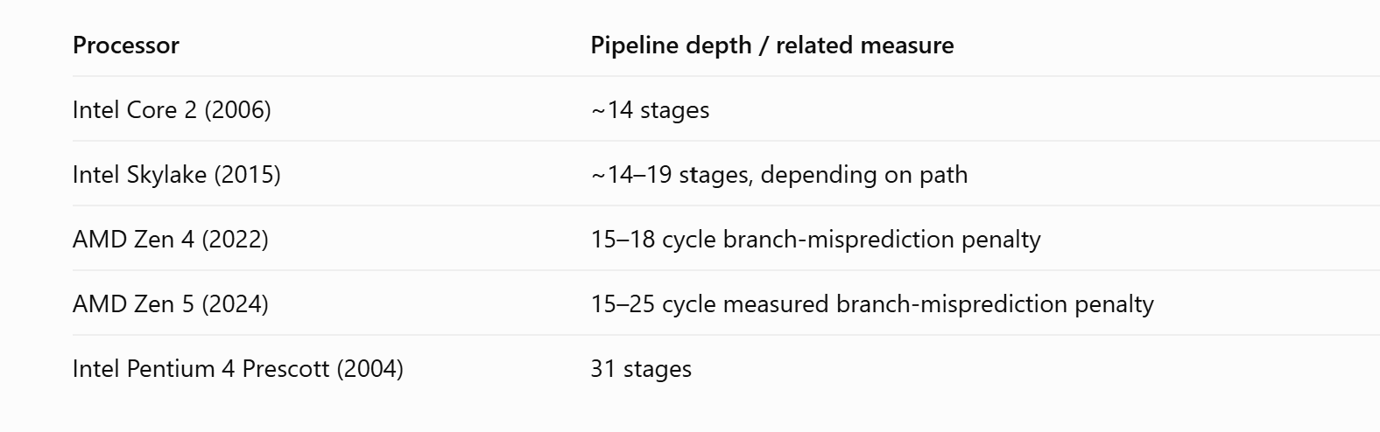
Comments #1:
Pipeline depth of modern processors

Slide 12
Comments #2:
Pipeline optimization applies to software as well

Slide 13
Our lecture: 5-stage pipeline
1
2
3
4
5
6
7
8
9
irmovq $1,%rax #I1
F
D
E
M
W
irmovq $2,%rcx #I2
F
D
E
M
W
irmovq $3,%rdx #I3
F
D
E
M
W
irmovq $4,%rbx #I4
F
D
E
M
W
halt #I5
F
D
E
M
W
Cycle 5
W
I1
M
I2
E
I3
D
I4
F
I5
Notes:
Critical

Slide 14
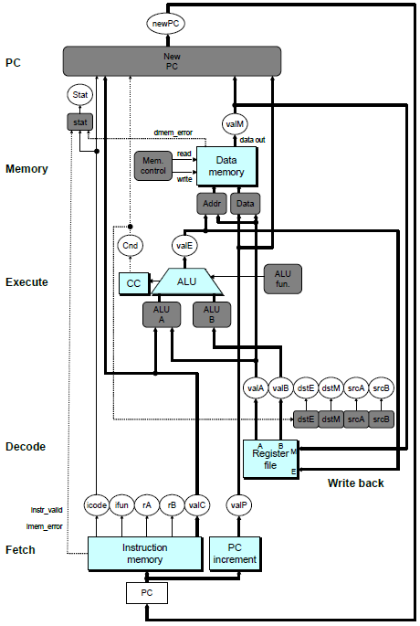
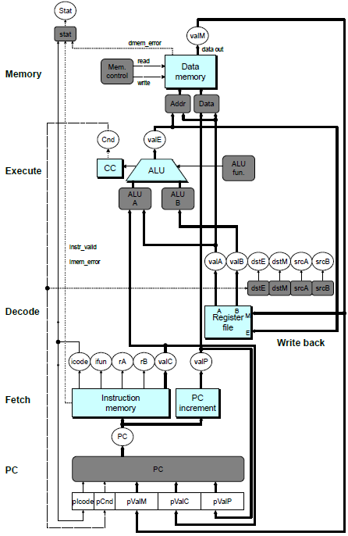
Notes:
Move PC to the first stage

Slide 15
来点CSAPP笑话
学生：老师，SEQ+ 是什么？
老师：为了引出流水线而设计的中间架构。
学生：那为什么不直接讲SEQ+而要讲SEQ？
老师：你这个问题问到了 CSAPP 的核心机密。

Slide 16
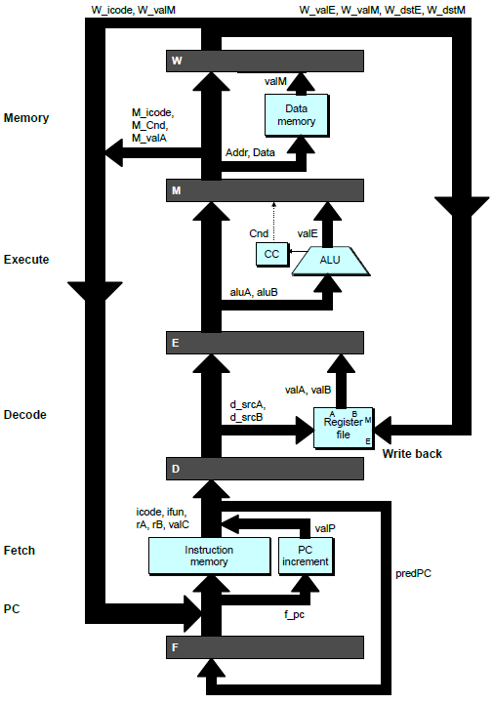
Adding Pipeline Registers
PC
newPC
valE
,
valM
Write back
valM
Data
Memory
Data
memory
memory
Addr
, Data
valE
CC
CC
ALU
Execute
Cnd
ALU
aluA
,
aluB
valA
,
valB
Decode
srcA
,
srcB
A
A
B
dstA
,
dstB
B
M
Register
M
Register
Register
Register
file
file
file
file
E
E
icode
,
ifun
valP
rA
,
rB
valC
Instruction
PC
Instruction
PC
Fetch
memory
increment
memory
increment
PC
Notes:
Critical

Slide 17
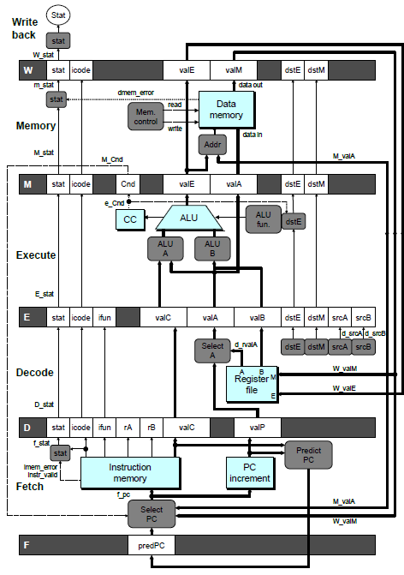

Slide 18
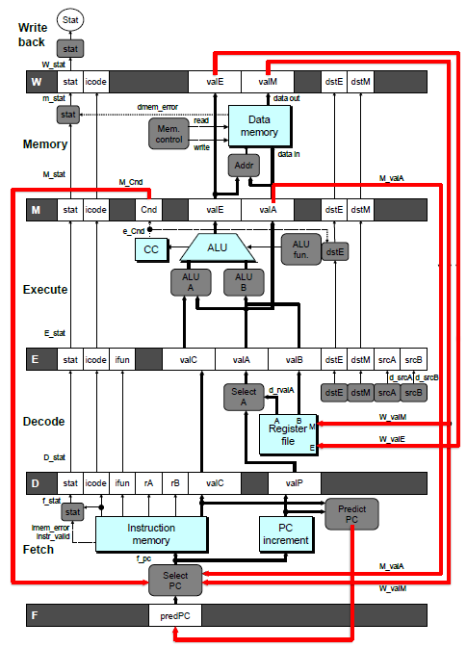
Feedback Paths
Predicted PC
  Guess value of next PC
Register updates
  To register file write ports

Slide 19
Data dependency

Slide 20
Data Dependencies
# demo-h0.ys
1
2
3
4
5
6
7
8
0x000:
irmovq
$10,%
rdx
F
D
E
M
W
0x00a:
irmovq
$3,%
rax
F
D
E
M
W
0x014:
addq
%
rdx
,%
rax
F
D
E
M
W
0x016: halt
F
D
E
M
W
Cycle 4
M
M_
valE
= 10
M_
dstE
=
%
rdx
E
e_
valE
f
0 + 3 = 3
E_
dstE
=
%
rax
D
D
Error
f
valA
f
valA
R[
R[
]
]
=
=
0
%
0
%
rdx
rdx
f
valB
f
valB
R[
R[
]
]
=
=
0
%
0
%
rax
rax
Notes:
Critical

Slide 21
Solution #1: The programmer or compiler inserts no-ops

Slide 22
Data Dependencies: 1 Nop
# demo-h1.ys
1
2
3
4
5
6
7
8
9
0x000:
irmovq
$10,%
rdx
F
D
E
M
W
0x00a:
irmovq
$3,%
rax
F
D
E
M
W
F
F
D
D
E
E
M
M
W
0x014:
nop
W
F
F
D
D
E
E
M
M
W
0x015:
addq
%
rdx
,%
rax
W
F
F
D
D
E
E
M
M
W
0x017: halt
W
Cycle 5
W
W
f
R[
f
R[
]
]
10
%
10
%
rdx
rdx
M
M_
valE
= 3
M_
dstE
=
%
rax
•
•
•
D
D
Error
f
valA
f
valA
R[
R[
]
]
=
=
0
%
0
%
rdx
rdx
f
valB
f
valB
R[
R[
]
]
=
=
0
%
0
%
rax
rax

Slide 23
Data Dependencies: 2 Nops
# demo-h2.ys
1
2
3
4
5
6
7
8
9
10
F
F
D
D
E
E
M
M
W
0x000:
irmovq
$10,%
rdx
W
F
F
D
D
E
E
M
M
W
0x00a:
irmovq
$3,%
rax
W
F
F
D
D
E
E
M
M
W
0x014:
nop
W
F
F
D
D
E
E
M
M
W
0x015:
nop
W
F
F
D
D
E
E
M
M
W
0x016:
addq
%
rdx
,%
rax
W
F
F
D
D
E
E
M
M
W
0x018: halt
W
Cycle 6
W
W
W
f
f
R[
f
R[
R[
]
]
]
3
3
%
3
%
%
rax
rax
rax
•
•
•
•
•
•
D
D
D
f
f
valA
f
valA
valA
R[
R[
R[
]
]
]
=
=
=
10
10
%
10
Error
%
%
rdx
rdx
rdx
f
f
valB
f
valB
valB
R[
R[
R[
]
]
]
=
=
=
0
0
%
0
%
%
rax
rax
rax

Slide 24
Data Dependencies: 3 Nop’s
# demo-h3.ys
1
2
3
4
5
6
7
8
9
10
11
F
F
D
D
E
E
M
M
W
0x000:
irmovq
$10,%
rdx
W
F
F
D
D
E
E
M
M
W
0x00a:
irmovq
$3,%
rax
W
F
F
D
D
E
E
M
M
W
0x014:
nop
W
F
F
D
D
E
E
M
M
W
0x015:
nop
W
F
F
D
D
E
E
M
M
W
0x016:
nop
W
F
F
D
D
E
E
M
M
W
0x017:
addq
%
rdx
,%
rax
W
F
F
D
D
E
E
M
M
W
0x019: halt
W
Cycle 6
W
W
f
R[
f
R[
]
]
3
%
3
%
rax
rax
Cycle 7
D
D
f
valA
f
valA
R[
R[
]
]
=
=
10
%
10
%
rdx
rdx
f
valB
f
valB
R[
R[
]
]
=
=
3
%
3
%
rax
rax
Notes:
Critical

Slide 25
Solution #2: Why not just let the HW do it?

Slide 26
Hardware bubble == nop
# demo-h2.ys
1
2
3
4
5
6
7
8
9
10
11
0x000: irmovq $10,%rdx
F
D
E
M
W
0x00a: irmovq $3,%rax
F
D
E
M
W
0x014: nop
F
D
E
M
W
0x015: nop
F
D
E
M
W
bubble
E
M
W
0x016: addq %rdx,%rax
F
D
D
E
M
W
0x018: halt
F
F
D
E
M
W
  Two tasks:
    Hold the addq instruction in decode stage
    Inject nop into execute stage

Slide 27
Stalling X3
# demo-h0.ys
1
2
3
4
5
6
7
8
9
10
11
0x000: irmovq $10,%rdx
F
D
E
M
W
0x00a: irmovq $3,%rax
F
D
E
M
W
bubble
E
M
W
bubble
E
M
W
bubble
E
M
W
0x014: addq %rdx,%rax
F
D
D
D
D
E
M
W
0x016: halt
F
F
F
F
D
E
M
W

Slide 28
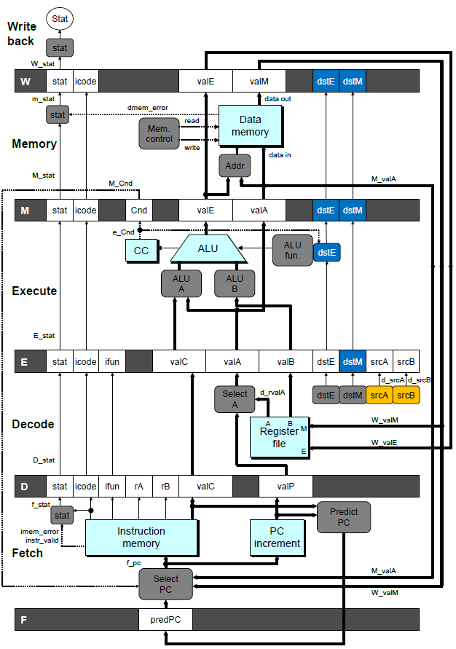
Stall Condition
Source Registers
  Decode: srcA and srcB
Destination Registers
  Ex, MEM, WB: dstE and dstM
Special Case
  Don’t stall for register ID 15 (0xF)
  Or failed cond. move

Slide 29
Detecting Stall Condition
# demo-h2.ys
1
2
3
4
5
6
7
8
9
10
11
0x000: irmovq $10,%rdx
F
D
E
M
W
0x00a: irmovq $3,%rax
F
D
E
M
W
0x014: nop
F
D
E
M
W
0x015: nop
F
D
E
M
W
bubble
E
M
W
0x016: addq %rdx,%rax
F
D
D
E
M
W
0x018: halt
F
F
D
E
M
W
Cycle 6
W
W_dstE = %rax
W_valE = 3
•
•
•
D
srcA = %rdx
srcB = %rax

Slide 30
Stalling X3
# demo-h0.ys
1
2
3
4
5
6
7
8
9
10
11
0x000: irmovq $10,%rdx
F
D
E
M
W
0x00a: irmovq $3,%rax
F
D
E
M
W
bubble
E
M
W
bubble
E
M
W
bubble
E
M
W
0x014: addq %rdx,%rax
F
D
D
D
D
E
M
W
0x016: halt
F
F
F
F
D
E
M
W
Cycle 6
W
Cycle 5
W_dstE = %rax
M
Cycle 4
M_dstE = %rax
•
•
•
E
•
•
•
e_dstE = %rax
D
D
D
srcA = %rdx
srcB = %rax
srcA = %rdx
srcB = %rax
srcA = %rdx
srcB = %rax

Slide 31
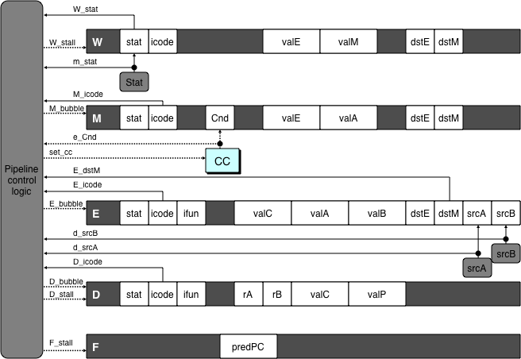
Implementing Stalling
Pipeline Control
  Combinational logic detects stall condition
  Sets mode signals for how pipeline registers should update

Slide 32
Pipeline Register Modes
Rising
Rising
Input = y
Output = x
_
clock
_
Output = y
clock
Normal
x
x
y
y
stall
bubble
= 0
= 0
Rising
Rising
Input = y
Output = x
_
clock
_
Output = x
clock
Stall
x
x
x
x
stall
bubble
= 1
= 0
Rising
Rising
Input = y
Output = x
_
clock
_
Output =
nop
clock
n
Bubble
x
x
o
p
stall
bubble
= 0
= 1
Notes:
Critical

Slide 33
Solution #3: Can we do it without slowing performance?

Slide 34
Data Forwarding
Observation
  Value already generated in execute or memory stage, no need to wait for the completion of the instruction
Trick
  Pass value directly from generating instruction to decode stage

Slide 35
Data Forwarding Example
# demo-h2.ys
1
2
3
4
5
6
7
8
9
10
F
F
D
D
E
E
M
M
W
0x000:
irmovq
$10,%
rdx
W
F
F
D
D
E
E
M
M
W
0x00a:
irmovq
$3,%
rax
W
F
F
D
D
E
E
M
M
W
0x014:
nop
W
F
F
D
D
E
E
M
M
W
0x015:
nop
W
F
F
D
D
E
E
M
M
W
0x016:
addq
%
rdx
,%
rax
W
F
F
D
D
E
E
M
M
W
0x018: halt
W
  irmovq in write-back stage
  Forward rax value in WB to decode
Cycle 6
W
W_
dstE
=
%
rax
R[
%
rax
]
f
3
W_
valE
= 3
•
•
•
D
srcA
=
%
rdx
valA
f
R[
%
rdx
]
=
10
srcB
=
%
rax
valB
f
W_
valE
=
3

Slide 36
Data Forwarding Example #2
# demo-h0.ys
1
2
3
4
5
6
7
8
0x000: irmovq $10,%rdx
F
D
E
M
W
0x00a: irmovq $3,%rax
F
D
E
M
W
0x014: addq %rdx,%rax
F
D
E
M
W
0x016: halt
F
D
E
M
W
Register %rdx
  Forward from MEM
Register %rax
  Forward from EXE
Cycle 4
M
M_dstE = %rdx
M_valE = 10
E
E_dstE = %rax
e_valE f 0 + 3 = 3
D
srcA = %rdx
srcB = %rax
valA f M_valE = 10
valB f e_valE = 3
Notes:
Critical

Slide 37
Forwarding Priority
# demo-priority.ys
1
2
3
4
5
6
7
8
9
10
F
F
D
D
E
E
M
M
W
0x000: irmovq $1, %rax
W
F
F
D
D
E
E
M
M
W
0x00a: irmovq $2, %rax
W
F
F
D
D
E
E
M
M
W
0x014: irmovq $3, %rax
W
F
F
D
D
E
E
M
M
W
0x01e: rrmovq %rax, %rdx
W
F
F
D
D
E
E
M
M
W
0x020: halt
W
Multiple Forwarding Choices
  Use matching value from earliest pipeline stage
Cycle 5
W
W
f
R[
f
R[
]
]
3
%
1
%
rax
rax
W
M
f
R[
f
R[
]
]
3
%
2
%
rax
rax
W
E
f
R[
f
R[
]
]
3
%
3
%
rax
rax
D
D
D
f
f
valA
f
valA
valA
R[
R[
R[
]
]
]
=
=
=
10
10
%
?
%
%
rax
rdx
rdx
f
f
valB
f
valB
valB
R[
R[
0
%
rax
]
=
0
Notes:
Critical

Slide 38
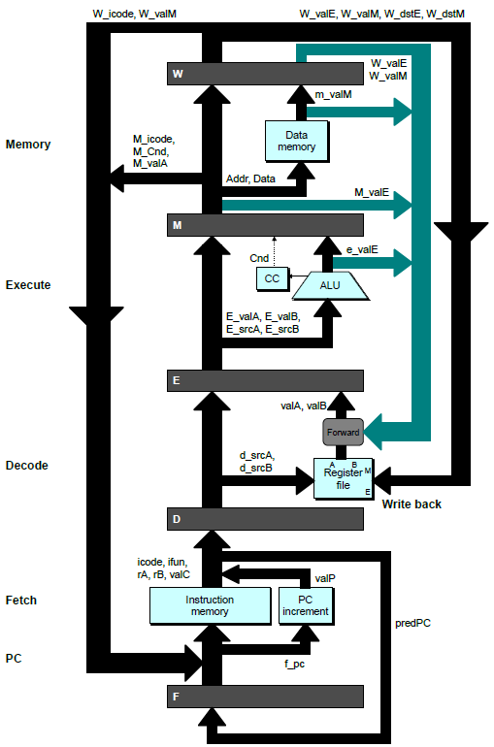
Bypass Paths
Decode Stage
  Forwarding: get valA or valB from later stages
Forwarding Sources
  Execute: valE
  Memory: valE, valM
  Write back: valE, valM

Slide 39
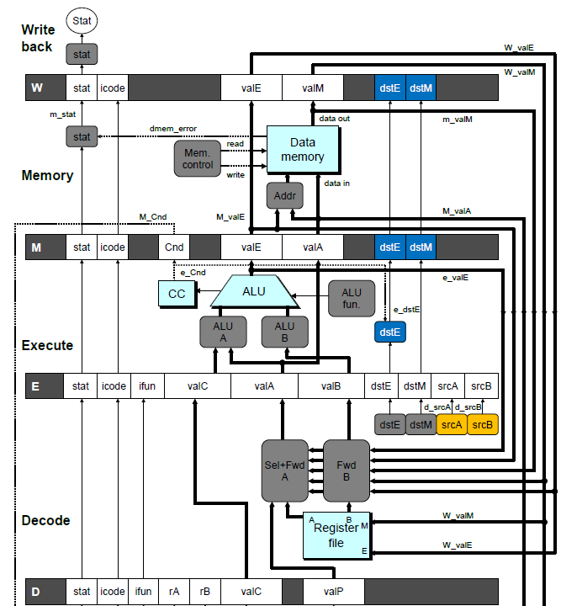
Implementing Forwarding
  Add additional feedback paths from E, M, and W
  Create logic to select from multiple sources for valA and valB

Slide 40
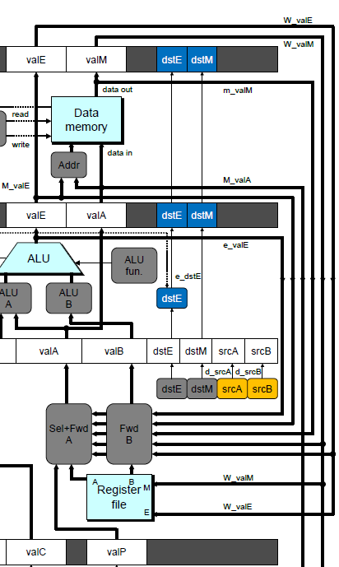
Implementing Forwarding
## What should be the A value?
int d_valA = [
# Use incremented PC
D_icode in { ICALL, IJXX } : D_valP;
# Forward valE from execute
d_srcA == e_dstE : e_valE;
# Forward valM from memory
d_srcA == M_dstM : m_valM;
# Forward valE from memory
d_srcA == M_dstE : M_valE;
# Forward valM from write back d_srcA == W_dstM : W_valM;
# Forward valE from write back
d_srcA == W_dstE : W_valE;
# Use value read from register file
1 : d_rvalA;
];

Slide 41
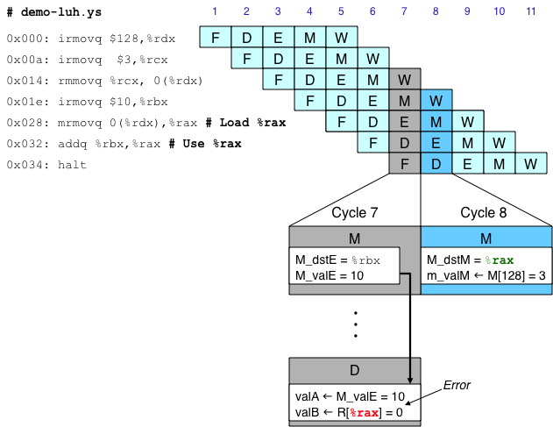
Limitation of Forwarding
Load-use dependency
  Value needed by end of decode stage in cycle 7
  Value read from memory in memory stage of cycle 8
Notes:
Critical

Slide 42
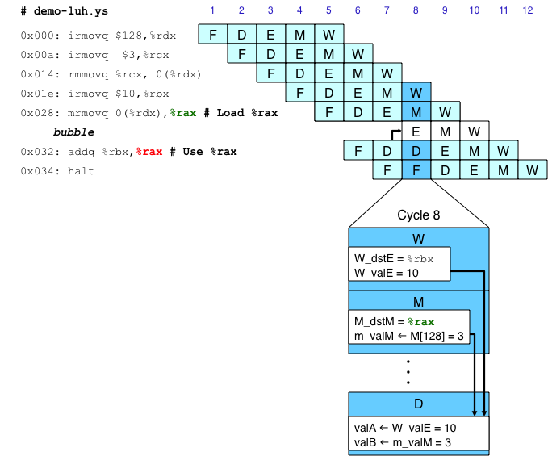
Avoiding Load/Use Hazard
  Stall using instruction for one cycle
  Can then pick up loaded value by forwarding from memory stage

Slide 43
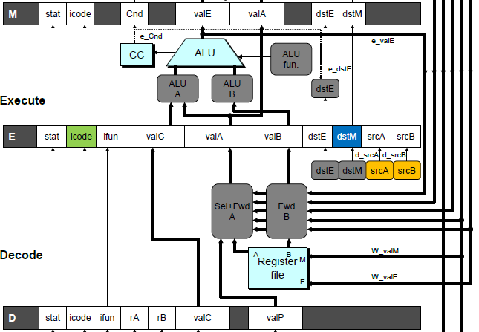
Detecting Load/Use Hazard
Condition | Trigger
Load/Use Hazard | E_icode in { IMRMOVQ, IPOPQ } && E_dstM in { d_srcA, d_srcB }

Slide 44
来点CSAPP笑话
学生：流水线为什么需要 no-op？
老师：因为后一条指令需要前面指令的计算结果。
学生：那为什么需要stall/bubble
老师：因为硬件可以直接弄，不需要编译器或者程序员insert no-op
学生：那为什么需要forwarding
老师：因为stall/bubble影响性能
学生：那为什么不直接讲forwarding
老师：因为我们用的是 CSAPP。

Slide 45
Branch (Mis)prediction

Slide 46
Branch Misprediction Example
demo-j.ys
0x000: xorq %rax,%rax
0x002: jne t # Not taken
0x00b: irmovq $1, %rax # Fall through
0x015: nop
0x016: nop
0x017: nop
0x018: halt
0x019: t: irmovq $3, %rdx # Target
0x023: irmovq $4, %rcx # Should not execute
0x02d: irmovq $5, %rdx # Should not execute
  After executing jne, which instruction should the processor execute next?
  The nextPC is not clear until the EXE stage!

Slide 47
Our Prediction Strategy
Call and Unconditional Jumps
  Predict next PC to be valC (destination)
  Always reliable
Conditional Jumps
  Predict next PC to be valC (destination)
  Only correct if branch is taken
    Typically right 60% (> 95%) of time

Slide 48
Branch Misprediction Example
demo-j.ys
0x000: xorq %rax,%rax
0x002: jne t # Not taken
0x00b: irmovq $1, %rax # Fall through
0x015: nop
0x016: nop
0x017: nop
0x018: halt
0x019: t: irmovq $3, %rdx # Target
0x023: irmovq $4, %rcx # Should not execute
0x02d: irmovq $5, %rdx # Should not execute
  Should only execute first 8 instructions

Slide 49
Branch Misprediction Trace
# demo
-
j
1
2
3
4
5
6
7
8
9
0x000:
xorq
%
F
D
E
M
W
rax
,%
rax
0x002:
jne
t # Not taken
F
D
E
M
W
0x019: t:
irmovq
$3, %
rdx
# Target
F
D
E
M
W
0x023:
irmovq
$4, %
rcx
# Target+1
F
D
E
M
W
F
F
D
D
E
E
M
M
W
0x00b:
irmovq
$1, %
rax
# Fall Through
W
Cycle 5
  Incorrectly execute two instructions at branch target
M
M_Cnd =
0
M_
valA
= 0x007
E
E
f
valE
f
valE
3
3
dstE
dstE
=
=
%
%
rdx
rdx
D
D
valC
valC
=
=
4
4
dstE
dstE
=
=
%
%
ecx
rcx
F
F
f
valC
f
valC
1
1
f
rB
f
rB
%
%
rax
rax
Notes:
Critical

Slide 50
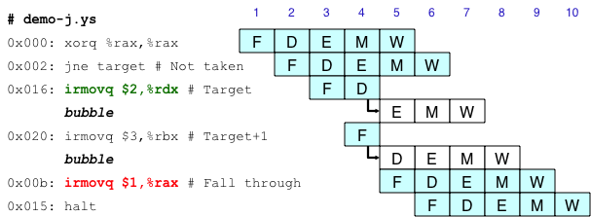
Handling Misprediction
Cancel when mispredicted
  Detect branch not-taken in execute stage
  On following cycle, replace the two instructions in execute and decode, respectively, by bubbles
  No ISA state changes have occurred yet
Notes:
Critical

Slide 51
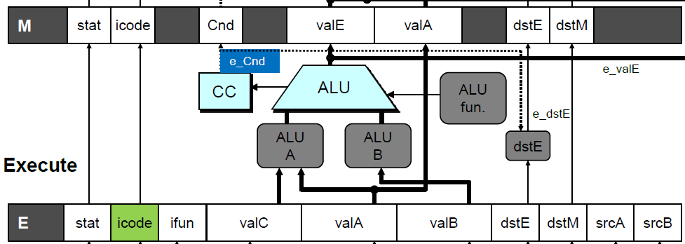
Detecting Mispredicted Branch
Condition | Trigger
Mispredicted Branch | E_icode == IJXX & !e_Cnd

Slide 52
Return

Slide 53
Return Example
demo-retb.ys
0x000: irmovq Stack,%rsp # Intialize stack pointer
0x00a: call p # Procedure call
0x013: irmovq $5,%rsi # Return point
0x01d: halt
0x020: .pos 0x20
0x020: p: irmovq $-1,%rdi # procedure
0x02a: ret
0x02b: irmovq $1,%rax # Should not be executed
0x035: irmovq $2,%rcx # Should not be executed
0x03f: irmovq $3,%rdx # Should not be executed
0x049: irmovq $4,%rbx # Should not be executed
0x100: .pos 0x100
0x100: Stack: # Stack: Stack pointer
  Previously executed three additional instructions

Slide 54
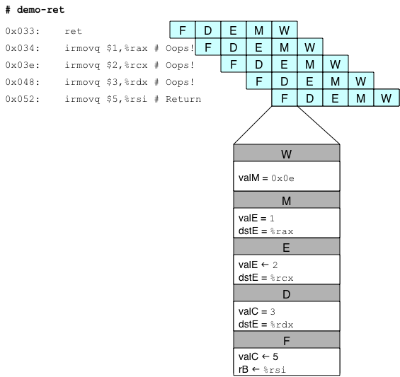
Incorrect Return Example
  Incorrectly execute 3 instructions following ret

Slide 55
Correct Return Example
# demo
-
retb
0x026: ret
F
D
E
M
W
bubble
F
D
E
M
W
bubble
F
D
E
M
W
bubble
F
D
E
M
W
F
F
D
D
E
E
M
M
W
0x013:
irmovq
$5,%
rsi
# Return
W
  As ret passes through pipeline, stall at fetch stage
    While in decode, execute, and memory stage
  Inject bubble into decode stage
  Release stall when reach write-back stage
W
W
valM
valM
=
=
0x0b
0x013
•
•
•
F
F
f
valC
f
valC
5
5
f
rB
f
rB
%
%
rsi
esi
Notes:
Critical

Slide 56
Why doesn’t return predict?

Slide 57
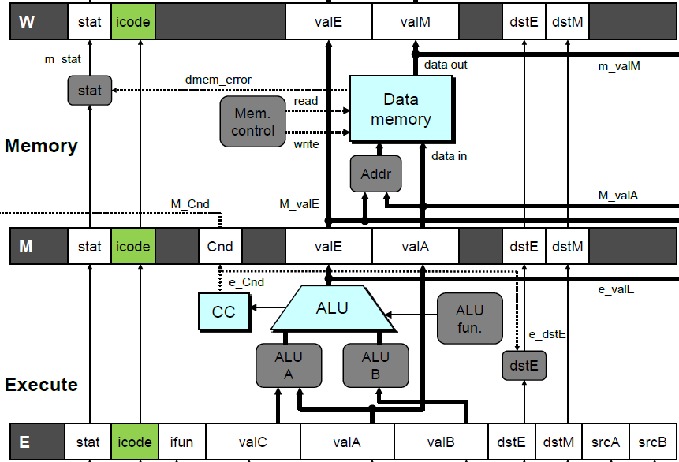
Detecting Return
Condition | Trigger
Processing ret | IRET in { D_icode, E_icode, M_icode }

Slide 58
Are we done?

Slide 59
Special Control Cases
Detection
Action (on next cycle)
Condition | Trigger
Processing ret | IRET in { D_icode, E_icode, M_icode }
Load/Use Hazard | E_icode in { IMRMOVQ, IPOPQ } && E_dstM in { d_srcA, d_srcB }
Mispredicted Branch | E_icode = IJXX & !e_Cnd
Condition | F | D | E | M | W
Processing ret | stall | bubble | normal | normal | normal
Load/Use Hazard | stall | stall | bubble | normal | normal
Mispredicted Branch | normal | bubble | bubble | normal | normal

Slide 60
Initial Version of Pipeline Control
bool F_stall =
# Conditions for a load/use hazard
E_icode in { IMRMOVQ, IPOPQ } && E_dstM in { d_srcA, d_srcB } ||
# Stalling at fetch while ret passes through pipeline
IRET in { D_icode, E_icode, M_icode };
bool D_stall =
# Conditions for a load/use hazard
E_icode in { IMRMOVQ, IPOPQ } && E_dstM in { d_srcA, d_srcB };
bool D_bubble =
# Mispredicted branch
(E_icode == IJXX && !e_Cnd) ||
# Stalling at fetch while ret passes through pipeline
IRET in { D_icode, E_icode, M_icode };
bool E_bubble =
# Mispredicted branch
(E_icode == IJXX && !e_Cnd) ||
# Load/use hazard
E_icode in { IMRMOVQ, IPOPQ } && E_dstM in { d_srcA, d_srcB };

Slide 61
The beauty and clearness of the CSAPP PIPE processor, which executes Y86 instructions efficiently, is at present obscured by two clouds…

Slide 62
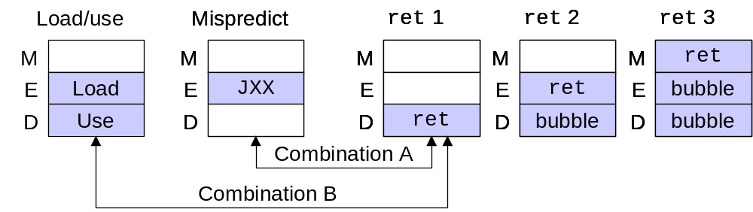
Control Combinations
  Special cases that can arise on same clock cycle
Combination A
  Not-taken branch
  ret instruction at branch target
Combination B
  Instruction that reads from memory to %rsp
  Followed by ret instruction

Slide 63
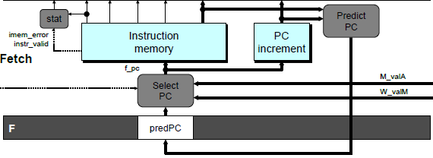
Control Combination A
1
1
Mispredict
1
Mispredict
ret
ret
ret
M
M
M
M
M
JXX
E
JXX
E
E
E
E
ret
ret
D
ret
D
D
D
D
Combination A
Condition | F | D | E | M | W
Processing ret | stall | bubble | normal | normal | normal
Mispredicted Branch | normal | bubble | bubble | normal | normal
Combination | stall | bubble | bubble | normal | normal
  Should handle as mispredicted branch
  Stalls F pipeline register
  JXX nullifies ret in EXE
  No additional logic is needed!

Slide 64
Control Combination B
1
1
Load/use
ret
1
ret
ret
M
M
M
M
E
Load
E
E
E
Use
ret
ret
D
D
ret
D
D
Combination B
Condition | F | D | E | M | W
Processing ret | stall | bubble | normal | normal | normal
Load/Use Hazard | stall | stall | bubble | normal | normal
Combination | stall | bubble + stall | bubble | normal | normal
  Would attempt to bubble and stall pipeline register D
  Signaled by processor as pipeline error
Notes:
Critical

Slide 65
Handling Control Combination B
1
1
Load/use
ret
1
ret
ret
M
M
M
M
E
Load
E
E
E
Use
ret
ret
D
D
ret
D
D
Combination B
Condition | F | D | E | M | W
Processing ret | stall | bubble | normal | normal | normal
Load/Use Hazard | stall | stall | bubble | normal | normal
Combination | stall | stall | bubble | normal | normal
  Load/use hazard should get priority
  ret instruction should be held in decode stage for additional cycle
Notes:
Critical

Slide 66
Corrected Pipeline Control Logic
bool D_bubble =
# Mispredicted branch
(E_icode == IJXX && !e_Cnd) ||
# Stalling at fetch while ret passes through pipeline
IRET in { D_icode, E_icode, M_icode }
# but not condition for a load/use hazard
&& !(E_icode in { IMRMOVQ, IPOPQ }
&& E_dstM in { d_srcA, d_srcB });
Condition | F | D | E | M | W
Processing ret | stall | bubble | normal | normal | normal
Load/Use Hazard | stall | stall | bubble | normal | normal
Combination | stall | stall | bubble | normal | normal
  Load/use hazard should get priority
  ret instruction should be held in decode stage for additional cycle
Notes:
Critical

Slide 67
来点CSAPP笑话
老师：今天我们讲一个很简单的概念：流水线
学生：太好了！
老师：首先，我们需要理解 SEQ、SEQ+、pipeline registers、stalling、
bubbling、forwarding、branch prediction、ret、以及它们的排列组合
学生…

Slide 68
来点CSAPP笑话
CSAPP 作者： 我们设计 Y86，是为了降低学生理解处理器的难度。
学生： 那为什么我学了 Y86，还是不理解处理器？
教师： 因为你还没学 SEQ。
学生： 学完 SEQ 呢？
教师： 还要学 SEQ+。
学生： 学完 SEQ+ 呢？
教师： 还要学 PIPE。
学生： 学完 PIPE 呢？
教师： 你就会理解为什么现代 CPU 不这么设计了。🤣🤣🤣

